Slide 1


Introduction to
Thomas Aglassinger
http://www.roskakori.at

Slide 2
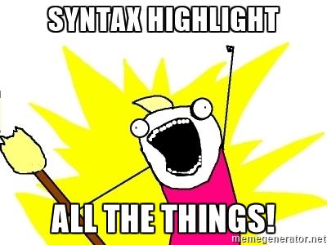
What is pygments?
Generic syntax highlighter
Suitable for use in code hosting, forums, wikis or other applications
Supports 300+ programming languages and text formats
Provides a simple API to
write your own lexers

Slide 3
Agenda
Basic usage
A glimpse at the API: lexers and tokens
Use case: convert source code
Use case: write your own lexer

Slide 4
Basic usage

Slide 5
Applications that use pygments
Wikipedia
Jupyter notebook
Sphinx documentation builder
Trac ticket tracker and wiki
Bitbucket source code hosting
Pygount source lines of code counter
(shameless plug)
And many others

Slide 6
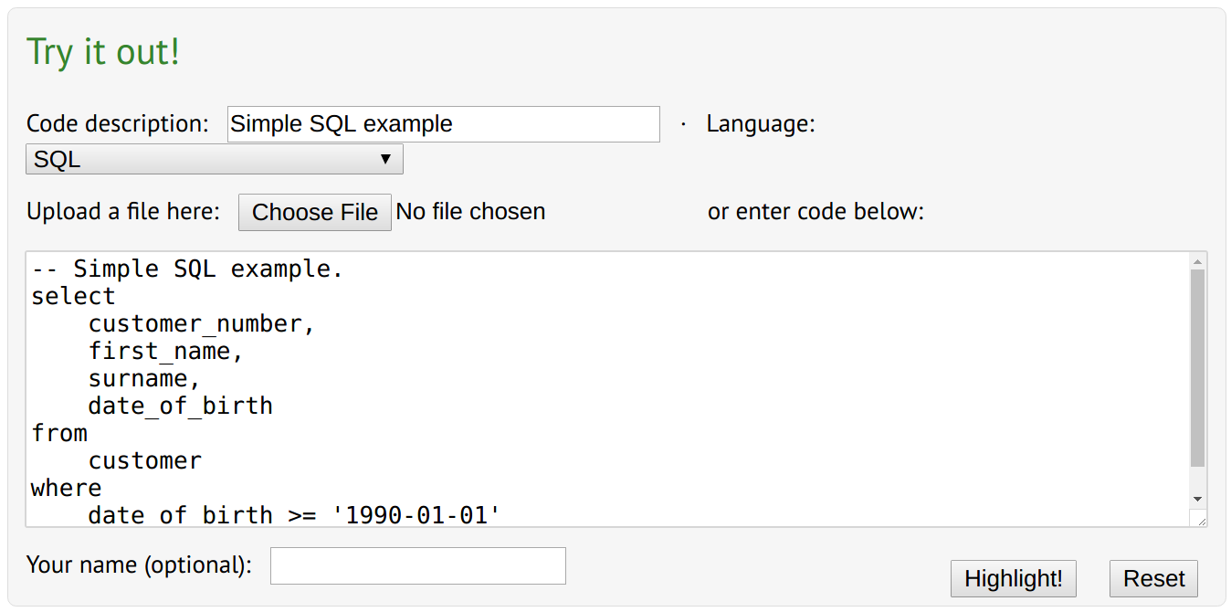
Try it online

Slide 7
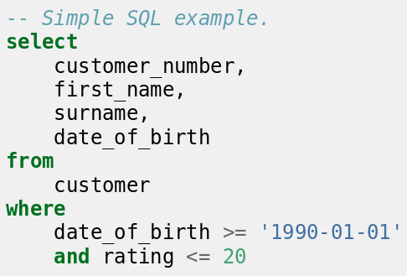
Try it online

Slide 8
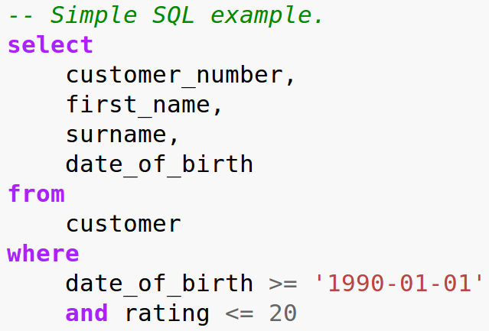
Use the command line
pygmentize -f html -O full,style=emacs
-o example.html example.sql
Renders example.sql to
example.html
Without
“-O full,style=emacs”
you have to provide your
own CSS
Other formats: LaTex, RTF, ANSI sequences

Slide 9
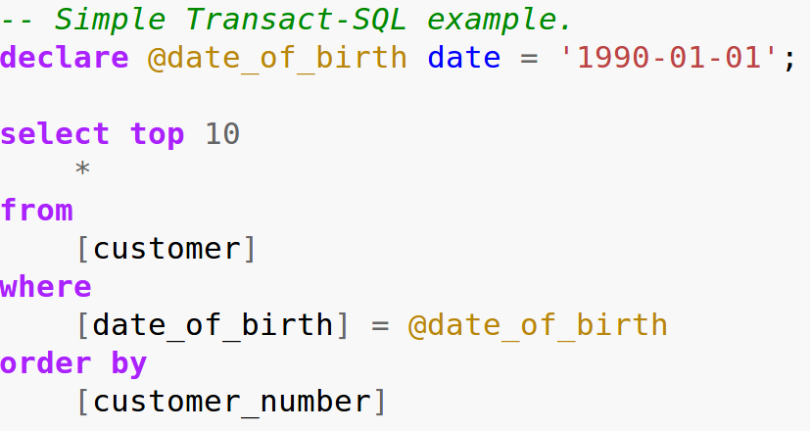
Choose a specific SQL dialect
There are many SQL dialects
Most use “.sql” as file suffix
Use “-l <lexer>”
to choose
a specific lexer
pygmentize -l tsql
-f html
-O full,style=emacs
-o example.html transact.sql

Slide 10
A glimpse at the API:
lexers and tokens

Slide 11
What are lexers?
Lexers split a text into a list of tokens
Tokens are strings with an assigned meaning
For example, a Python source code might resolve to tokens like:
  Comment: # Some comment
  String: ‘Hello\nworld!’
  Keyword: while
  Number: 1.23e-45
Lexers only see single “words”, parsers see the whole syntax

Slide 12
Split a source code into tokens
Source code for example.sql:

Slide 13
Tokens for example.sql
(Token.Comment.Single, '-- Simple SQL example.\n')
(Token.Keyword, 'select')
(Token.Text, '\n ')
(Token.Name, 'customer_number')
(Token.Punctuation, ',')
…
(Token.Operator, '>')
...
(Token.Literal.String.Single, "'1990-01-01'")
...
(Token.Literal.Number.Integer, '20')
...

Slide 14
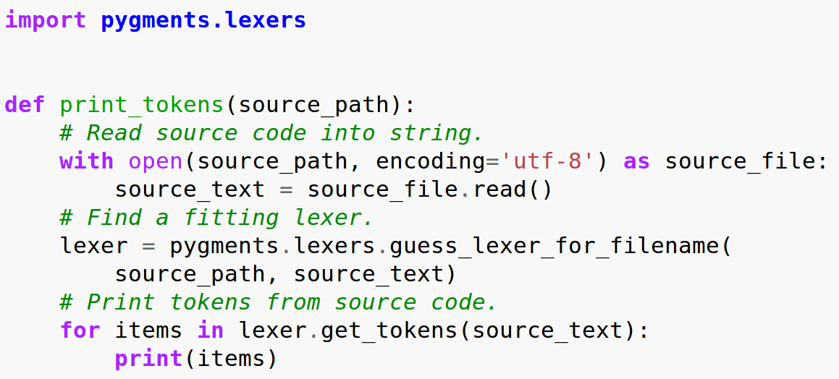
Source code to lex example.sql

Slide 15
Source code to lex example.sql
Obtain token
sequence
Find lexer
matching the
source code

Slide 16
Tokens in pygments
Tokens are tuples with 2 items:
  Type, e.g. Token.Comment
  Text, e.g. ‘# Some comment’
Tokens are defined in pygments.token
Some token types have subtypes, e.g. Comment has Comment.Single, Comment.Multiline etc.
In that case, use “in” instead of “==” to check if a token type matches, e.g.:
if token_type in pygments.token.Comment: ...

Slide 17
Convert source code

Slide 18
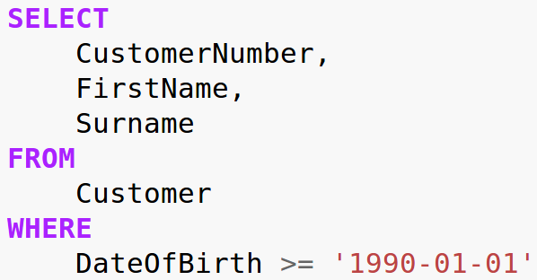
Convert source code
Why?
To match coding guidelines!
Example: “SQL keywords must be lower case”→ faster to read
Despite that, a lot of SQL code uses upper case for keywords.
Legacy from the mainframe era and when text editors did not have syntax highlighting.

Slide 19

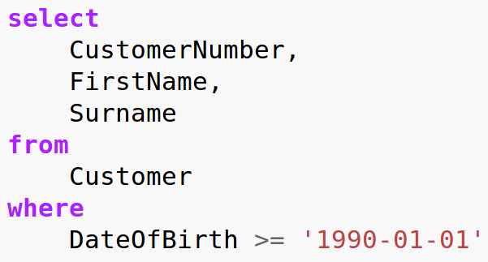
Convert source code

Slide 20
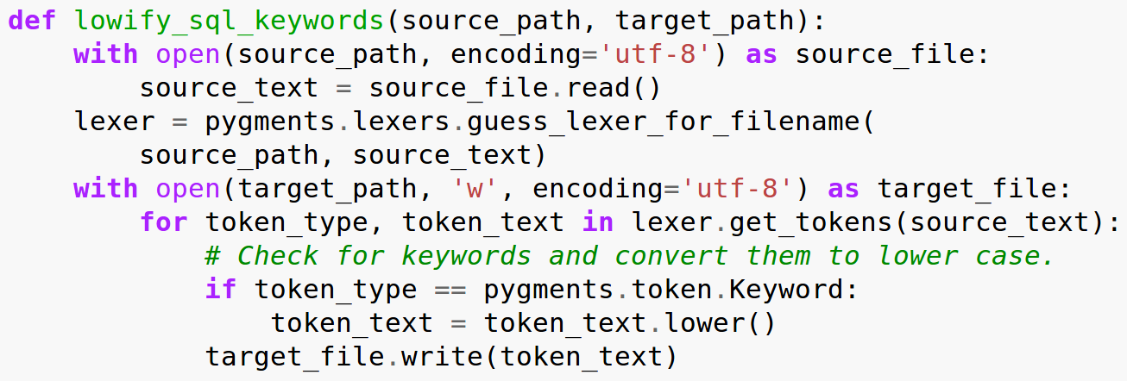
Convert source code
Check for keywords
and convert them
to lower case

Slide 21
Write your own lexer

Slide 22
Why write your own lexer?
To support new languages
To support obscure languages
(mainframe FTW!)
To support in house domain specific languages (DSL)

Slide 23

How to write your own lexer
All the gory details: http://pygments.org/docs/lexerdevelopment/
For most practical purposes, inherit from RegexLexer
Basic knowledge of
regular expressions
required (“import re”)

Slide 24
NanoSQL
Small subset if SQL
Comment: -- Some comment
Keyword: select
Integer number: 123
String: ‘Hello’; use ‘’ to escape
Name: Customer
Punctuation: .,;:

Slide 25
External lexers with pygmentize
Use -l and -x to:
pygmentize -f html -O full,style=emacs \
-l nanosqllexer.py:NanoSqlLexer -x \
-o example.html example.nsql

Slide 26
Source code

Slide 27
Conclusion

Slide 28
Summary
Pygments is a versatile Python package to syntax highlight over 300 programming languages and text formats.
Use pygmentize to create highlighted code.
Use lexers for code converters and analyzers.
Writing your own lexers is simple.

